Slide 1
CS-218 Data Structures
Week 4 | Lecture 1

Slide 2


Slide 3
Linked List
(Singly) Linked List is a data structure that has the following properties:
Successive elements are connected by pointers
The last element points to NULL
Can be made just as long as required (until systems memory exhausts)
Does not waste memory space (but takes some extra memory for pointers). It allocates memory as list grows.

Slide 4
Singly Linked List
Generally “linked list” means a singly linked list
This list consists of a number of nodes in which each node has a next pointer to the following element
The link of the last node in the list is NULL, which indicates the end of the list

Slide 5
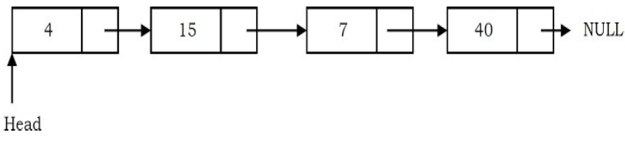
Linked List

Slide 6
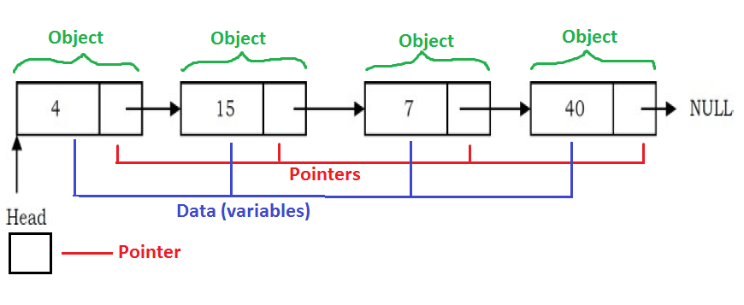
Linked List

Slide 7
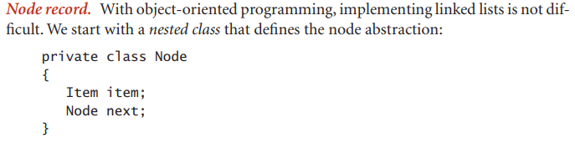
Code Snippet

Slide 8
class CustomLL {
class Node {
String data;
Node next;
Node(String data){
this.data=data;
this.next=null;
}
}
}

Slide 9
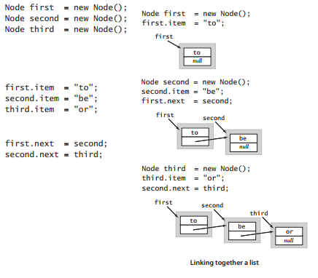

Slide 10
Basic Operations
Traversing the list
Inserting an item in the list
Deleting an item from the list

Slide 11
Traversal in Linked List
Visiting (accessing) each node of the list exactly once
Start from head node
Follow next pointer
Display/read contents as nodes are visited
Stop when next pointer equals NULL (or until desired node is found)

Slide 12
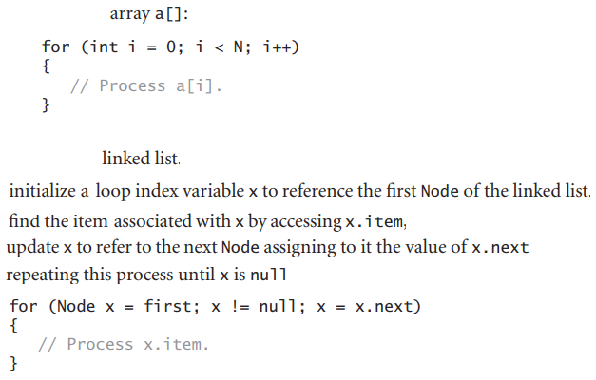
Code Snippet

Slide 13

With While loop?

Slide 14
Insertion in Singly Linked List
Inserting a new element to the list
Insertion into a singly-linked list has three cases:
CASE 1: Inserting a new node before the head (at the beginning)
CASE 2: Inserting a new node after the tail (at the end of the list)
CASE 3: Inserting a new node at the middle of the list (random location)

Slide 15
Case 1: Insertion at the Beginning
In this case, a new node is inserted before the current head node.
Only one next pointer needs to be modified (new node’s next pointer) and it can be done in two steps:
Update the next pointer of new node, to point to the current head.
Update head pointer to point to the new node.

Slide 16
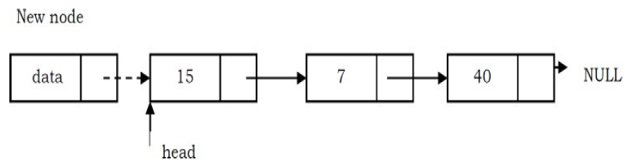
Case 1: Insertion at the Beginning
Update the next pointer of new node, to point to the current head.

Slide 17
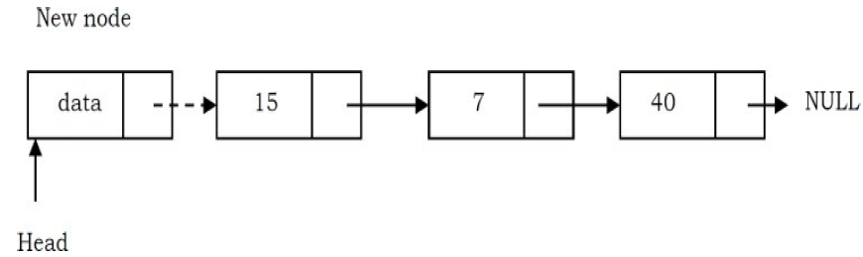
Case 1: Insertion at the Beginning
Update head pointer to point to the new node.

Slide 18
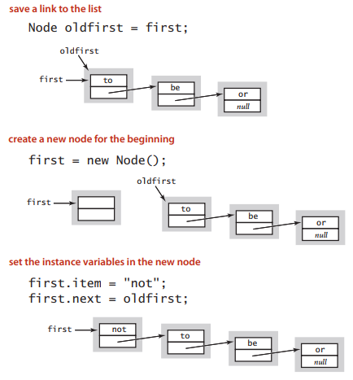
Code Snippet

Slide 19
Case 2: Insertion at the End
Traverse to last node (tail node)
We need to modify two next pointers (last nodes next pointer and new nodes next pointer).
New nodes next pointer points to NULL
Last nodes next pointer points to the new node

Slide 20
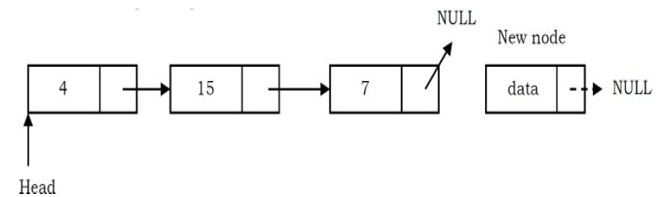
Case 2: Insertion at the End
New nodes next pointer points to NULL.

Slide 21
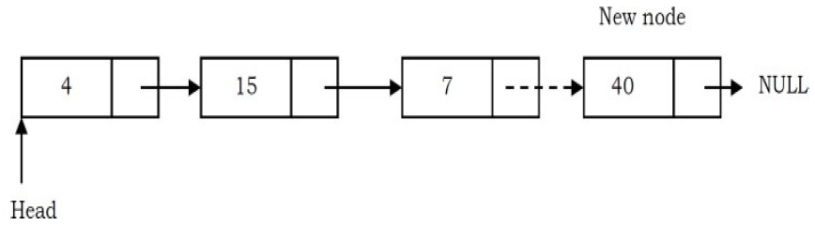
Case 2: Insertion at the End
Last nodes next pointer points to the new node

Slide 22
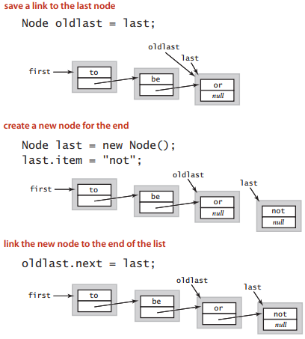
Code Snippet

Slide 23
Case 3: Insertion at the Middle
Traverse to node where insertion is to be made
In this case we need to modify two pointers:
The new node points to the next node of the position where we want to add this node
Next pointer of Position node (node before the newly inserted node) now points to the new node.

Slide 24
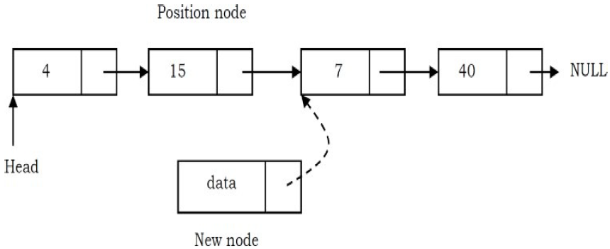
Case 3: Insertion at the Middle
The new node points to the next node of the position where we want to add this node.

Slide 25
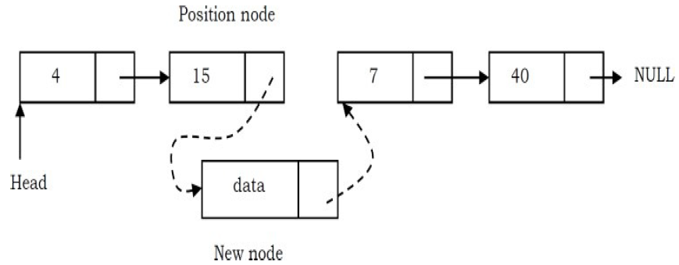
Case 3: Insertion at the Middle
Position node’s next pointer now points to the new node.

Slide 26
Code Snippet
void insertAt(int position, int data) { Node newNode = new Node(data); if (position == 0) { newNode.next = head; head = newNode; return; } Node current = head; int currentPosition = 0; while (current != null && currentPosition < position - 1) { current = current.next; currentPosition++; } | if (current == null) { System.out.println("Invalid position. List is not long enough."); return; } newNode.next = current.next; current.next = newNode; } void display() { Node current = head; while (current != null) { System.out.print(current.data + " -> "); current = current.next; } System.out.println("null"); } }

Slide 27
Deletion in Singly Linked List
Deleting an existing element from the list
Deletion into a singly-linked list has three cases:
CASE 1: Deleting head node
CASE 2: Deleting node from the middle of the list
CASE 3: Deleting tail node

Slide 28
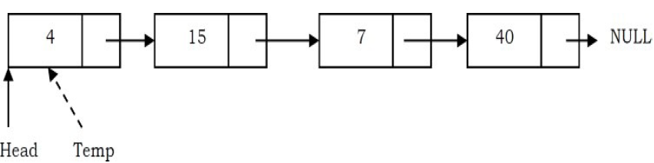
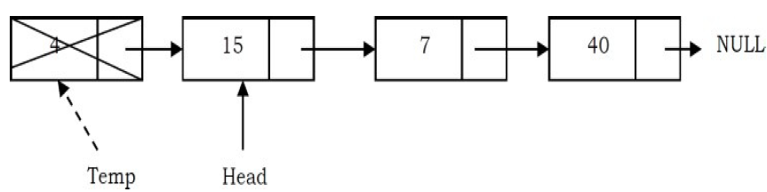
Case 1: Deletion at the Beginning
Create a temporary node which will point to the same node as that of head
Now, move the head nodes pointer to the next node and dispose of the temporary node

Slide 29
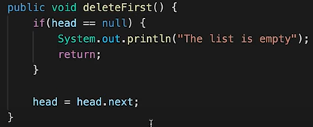
Code Snippet

Slide 30
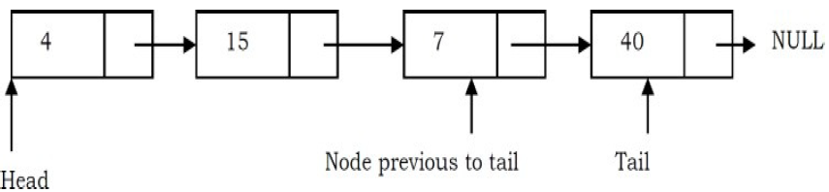
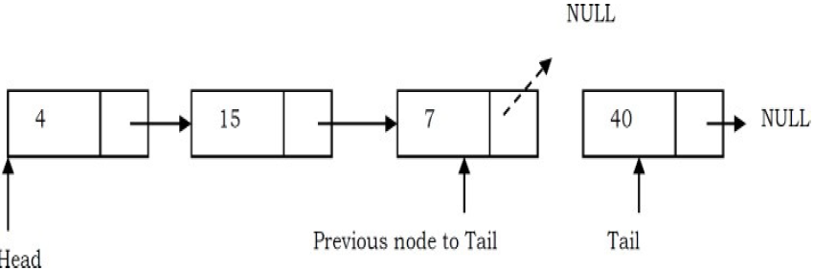
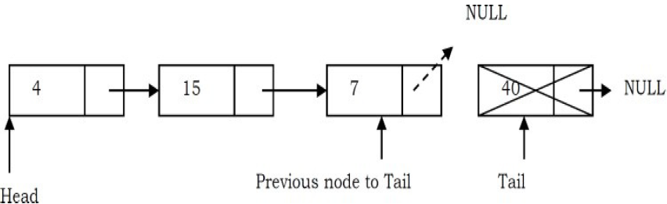
Case 2: Deletion at the End
Traverse the list and while traversing maintain the previous node address also
Update previous node’s next pointer with NULL
Dispose of the tail node

Slide 31
Code Snippet
Node prev=head;
Node curr=head.next;
while(curr.next != null){
curr=curr.next;
prev=prev.next;
}
prev.next=null;

Slide 32
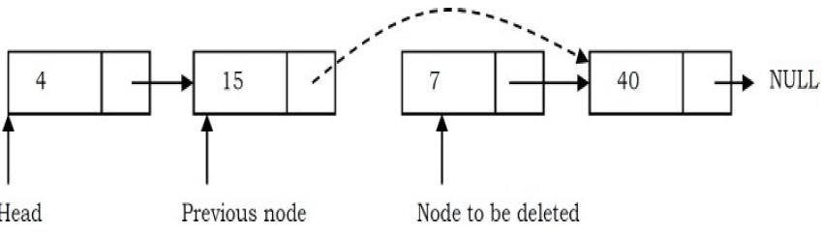
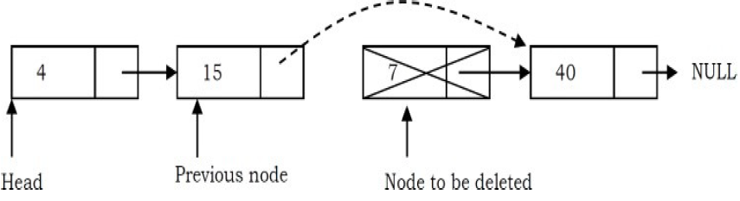
Case 3: Deletion at the Middle
Maintain the previous node while traversing the list. Once we find the node to be deleted, change the previous node’s next pointer to the next pointer of the node to be deleted
Dispose of the current node to be deleted

Slide 33
Code Snippet
Node curr; Node prev; curr = head; while(curr.next != null)
{
if(curr.data == 7) // assume node data 7 is to be deleted
break; prev = curr; curr = curr.next; }
prev.next = curr.next;

Slide 34
Advantages of Singly Linked List
Does not waste memory
Can grow or shrink during program execution
Can be made as long as required (until memory is exhausted)
“On-demand” memory allocation

Slide 35
Drawbacks of Singly Linked List
Insertion or deletion at the middle or end of list requires traversal (can take N traversals in worst case)
Searching is slower than arrays (since it requires traversal)
Not suitable for caching (due to no concept of proximity allocation)

Slide 36
Doubly Linked List
In a Doubly Linked List (also called two – way linked list), we can navigate in both directions
Each node has a pointer to its successor node (nextptr) and a pointer to its predecessor node (prevptr)

Slide 37
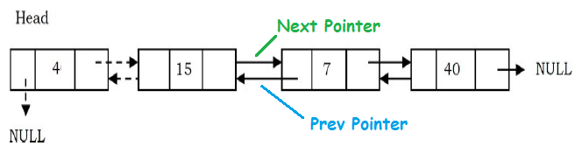
Doubly Linked List

Slide 38
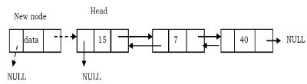
Insertion at Beginning of Doubly Linked List
Update the right pointer of the new node to point to the current head node and also make left pointer of new node as NULL

Slide 39

Insertion at Beginning of Doubly Linked List
Update head node’s left pointer to point to the new node and make new node as head

Slide 40

Insertion at End of Doubly Linked List
New node right pointer points to NULL and left pointer points to the end of the list

Slide 41

Insertion at End of Doubly Linked List
Update right pointer of last node to point to new node

Slide 42
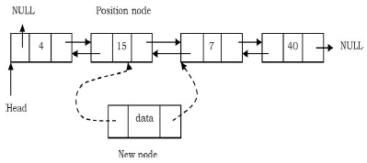
Insertion at Middle of Doubly Linked List
New node right pointer points to the next node of the position node where we want to insert the new node. Also, new node left pointer points to the position node

Slide 43
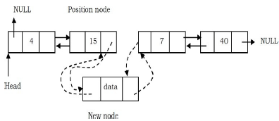
Insertion at Middle of Doubly Linked List
Position node right pointer points to the new node and the next node of position node left pointer points to new node

Slide 44
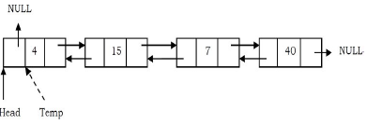
Deleting First Node of Doubly Linked List
Create a temporary node which will point to the same node as that of head

Slide 45
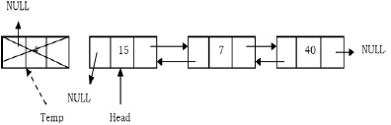
Deleting First Node of Doubly Linked List
Now, move the head nodes pointer to the next node and change the heads left pointer to NULL. Then, dispose of the temporary node

Slide 46
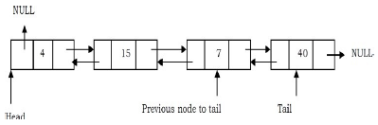
Deleting Last Node of Doubly Linked List
Traverse the list and while traversing maintain the previous node address also. By the time we reach the end of the list, we will have two pointers, one pointing to the tail and the other pointing to the node before the tail

Slide 47
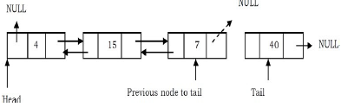
Deleting Last Node of Doubly Linked List
Update the next pointer of previous node to the tail node with NULL

Slide 48
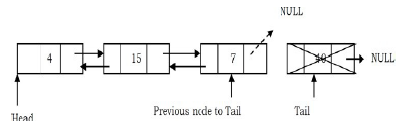
Deleting Last Node of Doubly Linked List
Dispose the tail node.

Slide 49
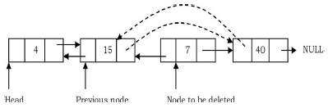
Deleting Intermediate Node of Doubly Linked List
Maintain the previous node while also traversing the list. Upon locating the node to be deleted, change the previous node’s next pointer to the next node of the node to be deleted

Slide 50
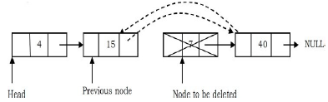
Deleting Intermediate Node of Doubly Linked List
Dispose of the current node to be deleted

Slide 51
Advantages of Doubly Linked List
In a doubly linked list, we can delete a node even if we don’t have the previous node’s address (since each node has a left pointer pointing to the previous node and can move backward)
Less expansive traversal

Slide 52
Drawbacks of Doubly Linked List
Each node requires an extra pointer, requiring more space
The insertion or deletion of a node takes a bit longer (more pointer operations)

Slide 53
Circular Linked List
Circular linked lists are those that do not have any end i.e. none of the nodes point to NULL
In circular linked lists, the next pointer of tail node points to head, thus creating a loop like structure

Slide 54
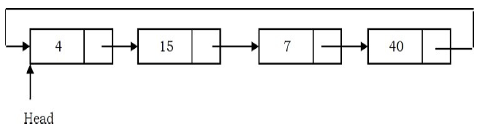
Circular Linked List

Slide 55
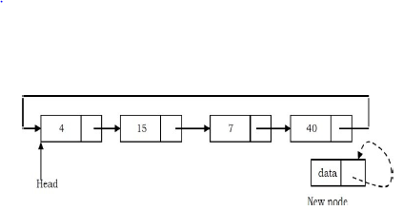
Insertion at the End of Circular Linked List
Create a new node and initially keep its next pointer pointing to itself

Slide 56
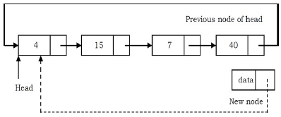
Insertion at the End of Circular Linked List
Update the next pointer of the new node with the head node and also traverse the list to the tail

Slide 57
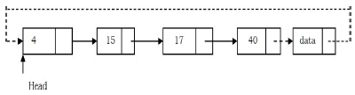
Insertion at the End of Circular Linked List
Update the next pointer of the previous node to point to the new node

Slide 58
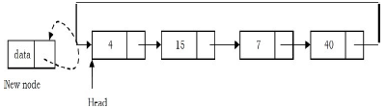
Insertion at the Beginning of Circular Linked List
Create a new node and initially keep its next pointer pointing to itself

Slide 59
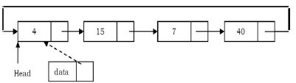
Insertion at the Beginning of Circular Linked List
Update the next pointer of the new node with the head node and also traverse the list until the tail

Slide 60
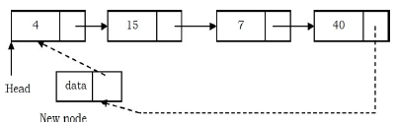
Insertion at the Beginning of Circular Linked List
Update the previous head node in the list to point to the new node

Slide 61

Insertion at the Beginning of Circular Linked List
Make the new node as the head

Slide 62
Insertion at the Middle of Circular Linked List
Same as insertion in middle of Singly Linked List

Slide 63
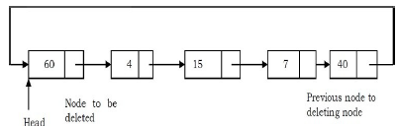
Deleting the First Node in a Circular List
Find the tail node of the linked list by traversing the list. Tail node is the previous node to the head node which we want to delete

Slide 64
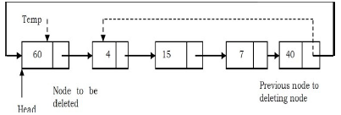
Deleting the First Node in a Circular List
Create a temporary node which will point to the head. Also, update the tail nodes next pointer to point to next node of head

Slide 65
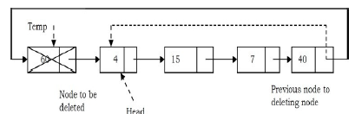
Deleting the First Node in a Circular List
Now, move the head pointer to next node. Create a temporary node which will point to head. Also, update the tail nodes next pointer to point to next node of head

Slide 66
Deleting the Middle Node in a Circular List
Same as deleting middle node in Singly Linked List

Slide 67
Deleting the Last Node in a Circular List
Same as deleting middle node in Singly Linked List

